Slide 1



KaggleX- Showcase Template
Notes:
Recommending picking out he most interesting and important parts from your documentation.

Slide 2
Presenter: Oriji Sandra Onyinyechi

Slide 3
Advanced Analytics Insights from Superstore Data: Unraveling Retail Trends and Patterns

Slide 4
Background
I am a Graduate of Biochemistry and a Data Analyst by Profession who is interested in everything Data.
As a Data Analyst my Current line of work is on Data Collection, Exploration, Visualization and Identifying insight and patterns in data.
I Build BI Dashboards with Power BI and Tableau, i used looker too.I work with SQL (preferable MySQL), i use postgresql and Python.
I aspire to be a Machine Learning Engineer and my research area will be on Big Data and Cloud Computing.

Slide 5
Project Definition
Project Summary
Product and Customers Analysis of Retail Time Series Data (Super Store).
This Project will be of two Part:
Data Exploration and Visualization: I used plotly and Streamlit to build interactive charts and dashboard.
Forecasting using Prophet: Used to build time series model

Slide 6
Project Definition
Data Science Topic(s)/Tools Applied
Data Analysis
Exploratory Data Analysis
Data Cleaning
Data Visualization
Python(plotly, pandas, prophet etc)
Analytics
Streamlit
Machine Learning

Slide 7
What I have Learnt
In this Project, i have learnt how to work with Time Series Data, explore, clean, visualise, identify trend and patterns.
Understood the factors that contribute to good Forecasting and what makes a good forecaster.
Looked at Basic Steps in Forecasting Task. Understood words in forecasting like Trends, Seasonality and Cyclic.
Learnt how to use plotly to build interactive charts, Streamlit to build an interactive Dashboard and Prophet to build time series models

Slide 8
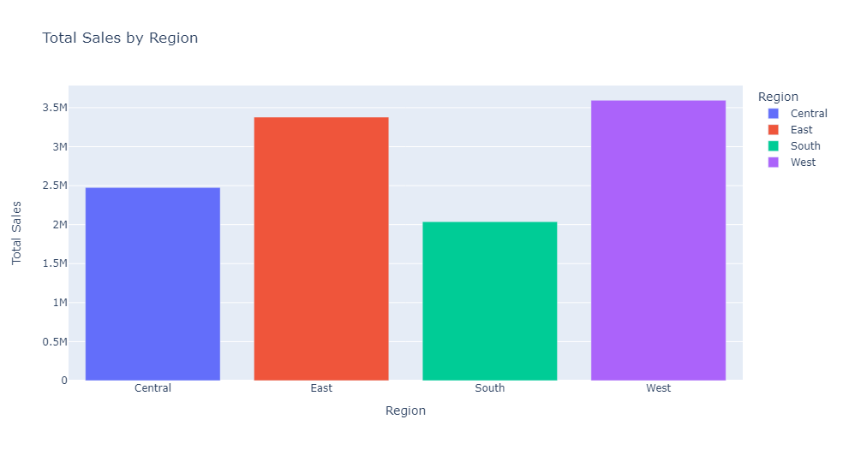
Data Visualization and Exploration
In my first Visualization i looked at the total Sales by Region.

Slide 9
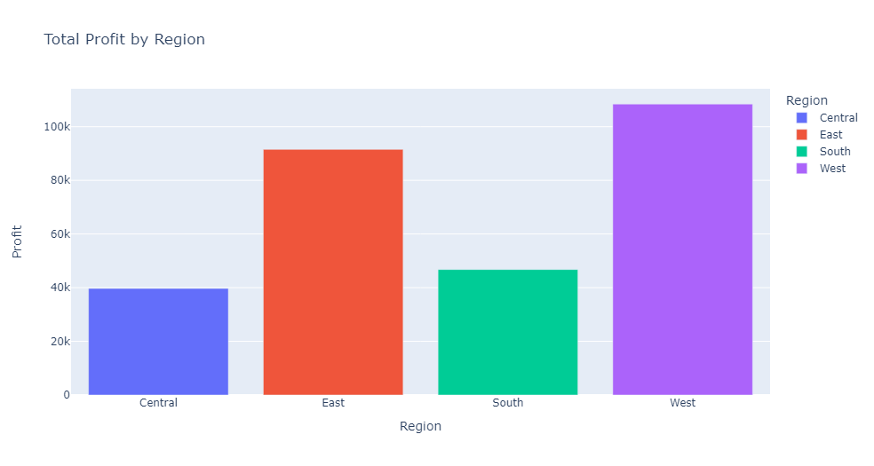
Data Visualization and Exploration
Next, i looked at the total Profit by Region.

Slide 10
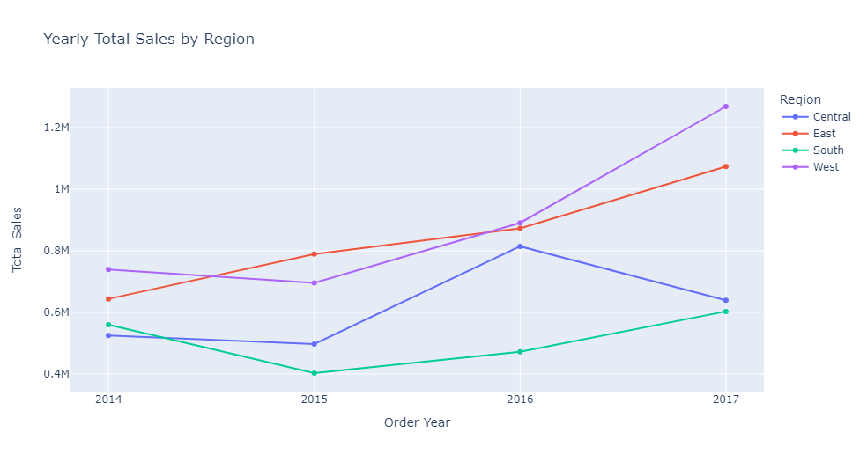
Data Visualization and Exploration
Yearly, total Sales by Region

Slide 11
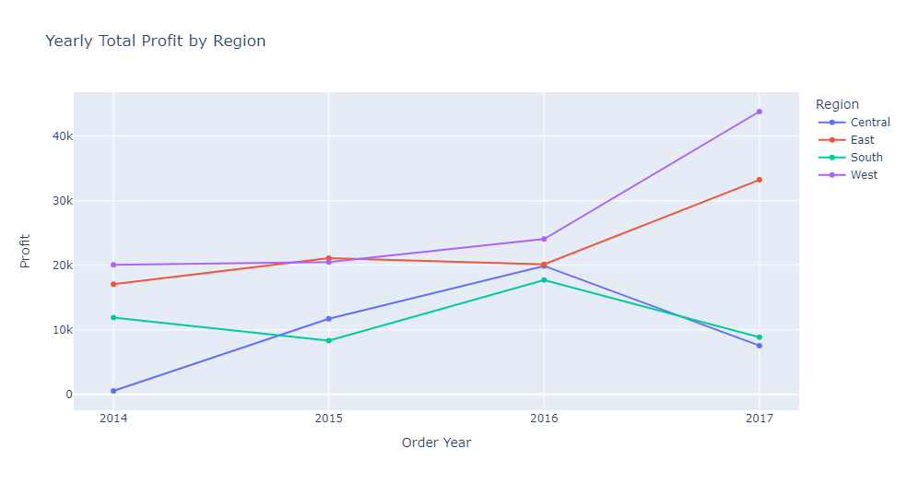
Data Visualization and Exploration
Yearly, Total Profit by Region

Slide 12
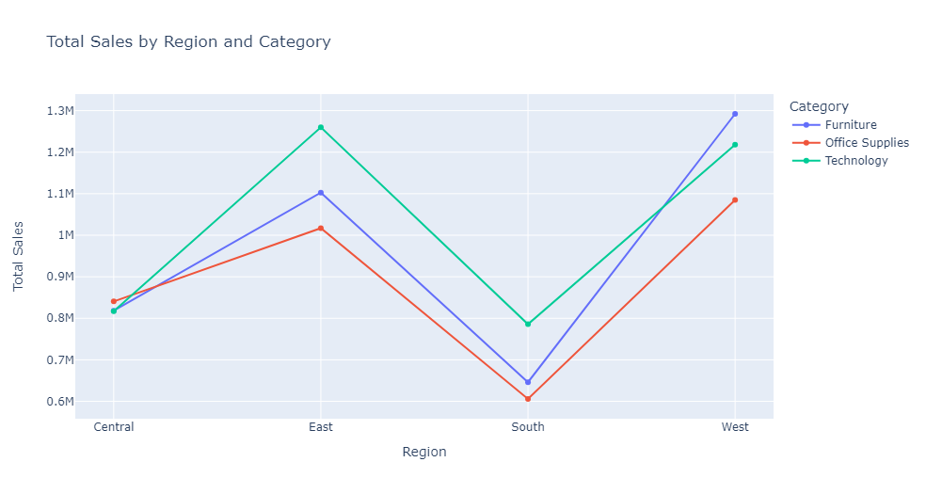
Data Visualization and Exploration
Total Sales by Region and Category

Slide 13
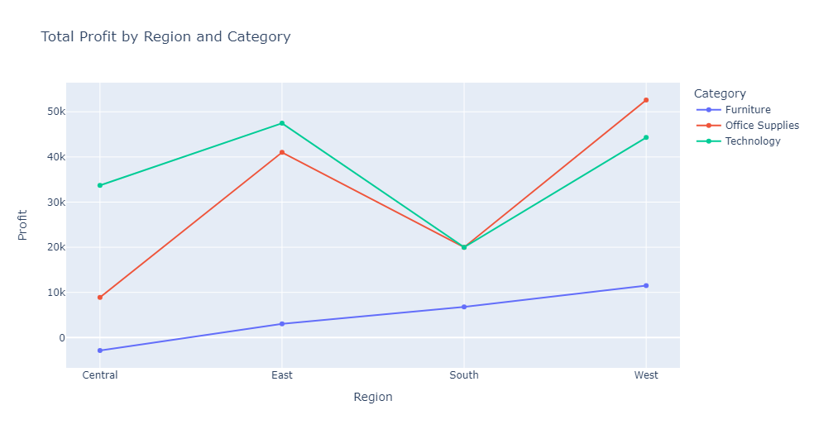
Data Visualization and Exploration
Total Profit by Region and Category

Slide 14
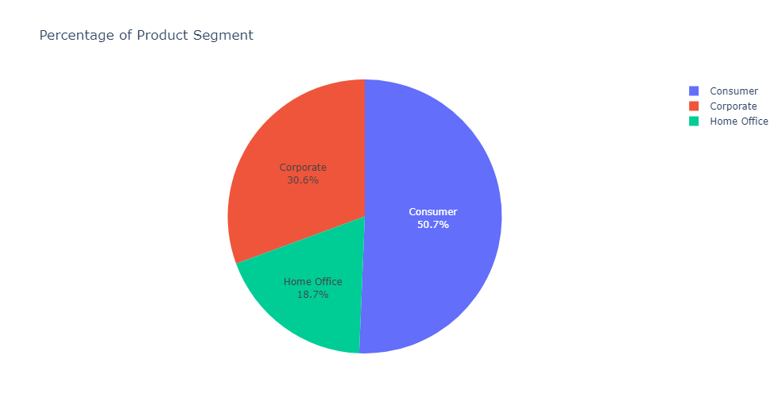
Data Visualization and Exploration
The products sold in the superstore is in three Segments (Corporate, Consumer, Home Office). In this visualization i looked at the percentage value of each segment in the data.

Slide 15
Forecasting Using Prophet
For the Forecast, we will be making use of Prophet a procedure for forecasting time series data based on an additive model where non-linear trends are fit with yearly, weekly and daily, plus holiday effect.
I will be using Prophet to predict regional (East, West, Central and South) total sales and profit.

Slide 16
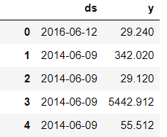

Forecasting Using Prophet
Prophet library expects as input a dataframe with one column containing the time information (Date), and another column containing the metric (in this case i want to forecast Total Sales) that we wish to forecast. Prophet also imposes the strict condition that the input columns must be named as ds (the date column) and y (the metric column). Let's rename our column

Slide 17
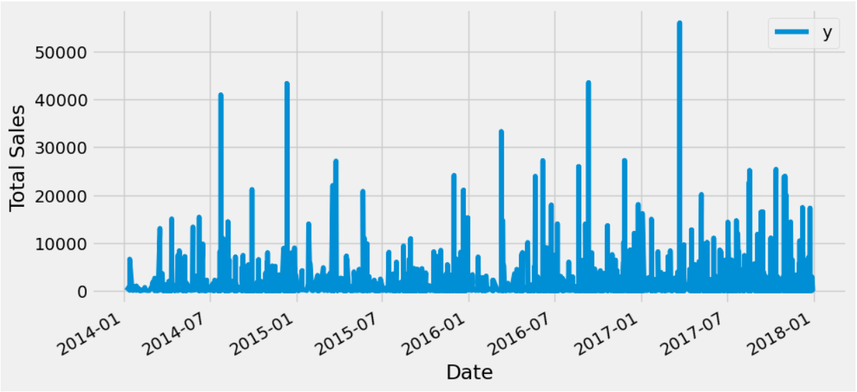
Forecasting Using Prophet
Plot the ds vs y

Slide 18
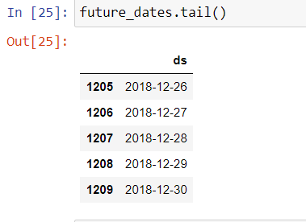
Forecasting Using Prophet
Prophet Package works with One time series at a time so filter one Region and take one region at a time.
df_west = data[data['Region'] == 'West']
model1 = Prophet(interval_width=0.95) # create prophet model
model1.fit(df_west) # fit the model to my data
future_dates = model1.make_future_dataframe(periods=365, freq='D')

Slide 19
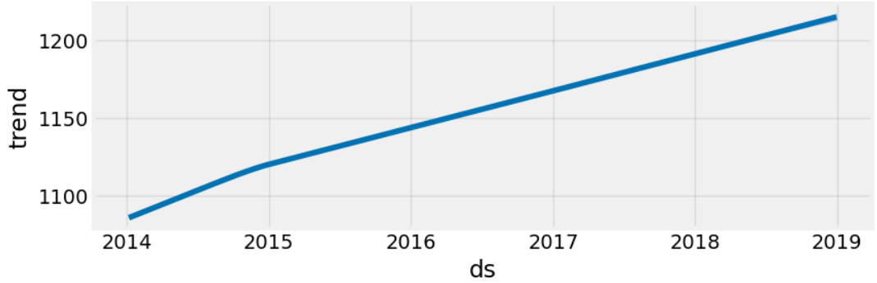
Forecasting Using Prophet
Next, i will plot the plot components the Trend, Weekly and, Yearly
plot2 = model1.plot_components(forecast)

Slide 20
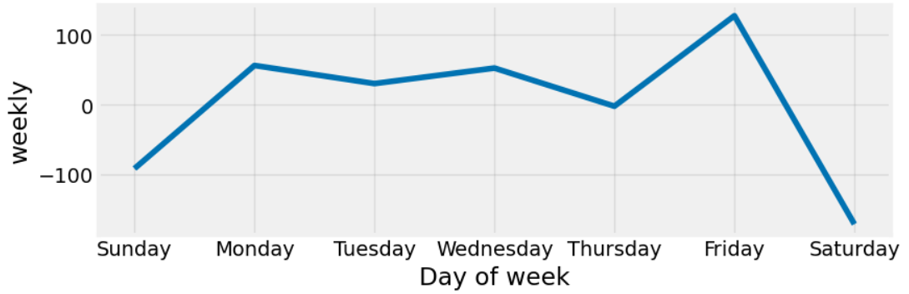
Forecasting Using Prophet

Slide 21
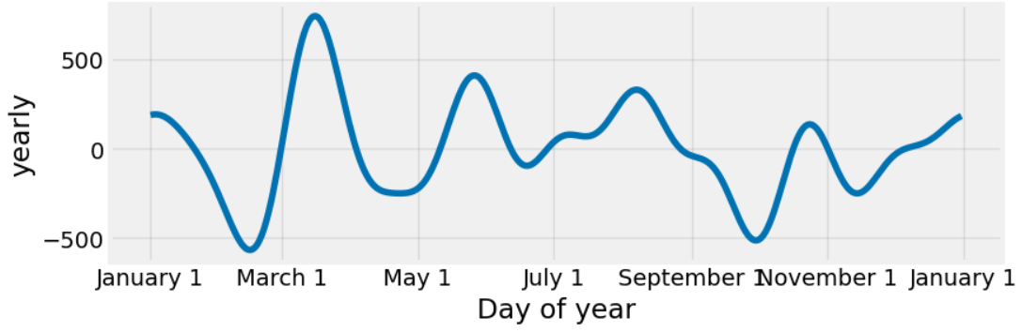
Forecasting Using Prophet

Slide 22
Forecasting Using Prophet
Cross Validation (CV)
CV is used to test the performance (accuracy) of the model on new data or unseen data.
CV helps to avoid creating inaccurate predictions
CV helps to assess the effectiveness of the ML model, in cases where we need to mitigate overfitting.
It is used in determining the parameters that needs turning and will result in the lowest test error.
I applied CV in my model by specifying the forecast horizon to 365 days, the initial training to 730 days (that is twice my horizon), and the period to 100 days.

Slide 23
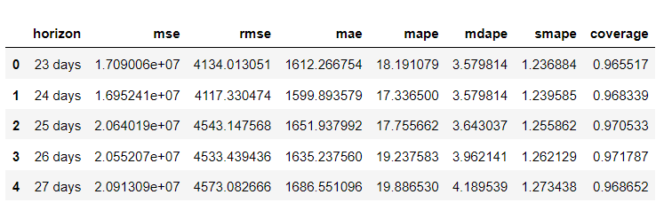
Forecasting Using Prophet
Performance Metrics

Slide 24
Useful Links
Superstores Dashboard using Streamlit - https://github.com/Onyinye91-ctrl/Superstore_Dashboard-Streamlit-
Superstore Sales - https://github.com/Onyinye91-ctrl/Superstore-Sales
Dataset in Kaggle - https://www.kaggle.com/datasets/vivek468/superstore-dataset-final
Streamlit App Dashboard - https://m35jf2fj6buemnvpxvmwfk.streamlit.app/
Medium Article: Building Interactive Charts with Plotly - https://medium.com/@oriji.sandra_21900/building-interactive-charts-with-plotly-07a379452c74
Prophet - https://facebook.github.io/prophet/docs/quick_start.html#python-api

Slide 25

Thank You.

